Slide 1
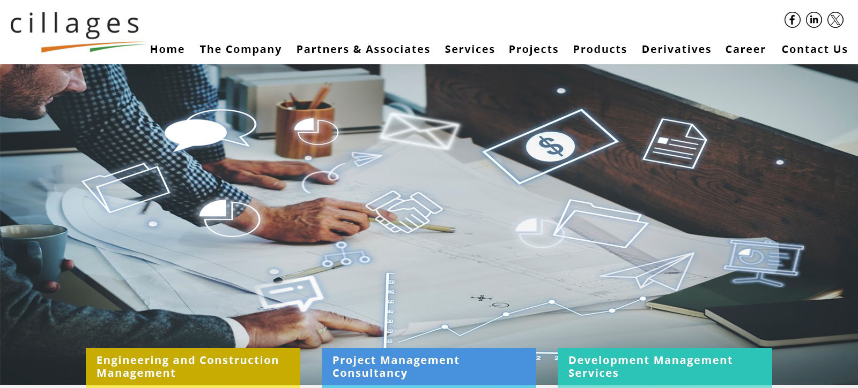
since 1993
PMC, EPC, DEVELOPMENT MANAGEMENT SERVICES
With ESG (Environmental, Social & Governance guidance)
Cillages Infra Pvt. Ltd
Mumbai, India

Slide 2
EXECUTIVE SUMMARY
Cillages
Cillages ; People Turning Visions into Realities, for over three Decades
A Project Management, EPC management and Development management Company
.
Right from acquisition and design management ; to User handover
Cillages is capable of taking end to end responsibility of a project
Cillages is an effort to lead confluence of Design, Culture and Technology to effect
Cities In Villages
3
DOORS ARE MOST PROMINENT BUILDING MONUMENTS IN THE WORLD

Slide 3
Principal Consultant – C&MD
Founded by Shailendra Maliwar
A Civil Engineer, SAP professional and accredited PMP (USA) with more than 40 years of experience in Project management and EPC Consultancy.
He has delivered many projects including three projects, each of which was more than 2 million square feet of mixed use in Mumbai city and,
a 320 acres township at Pune.
4

Slide 4
Team & holistic Approach
Cillages
Cillages is a Competent Core Team of people having requisite varied skill sets and a collaborative culture in – Project Management Techniques (including Scrum and Agile techniques), Construction Technologies (Building and Infra structure), Legal and Documentation, Communication and, Ground level operations management
Cillages Core Team includes –
Mr. Shailendra Maliwar, a project management expert
Mr. Shailesh Mehta, an infrastructure technology expert
Mr. J. D. Singh, a legal expert
Dr. Jyoti Maliwar, a Communication and Documentation Expert
At Cillages, we don't just manage projects – we provide comprehensive solutions that drive success at every stage of the project lifecycle. Partner with us and experience the difference of our holistic approach and strategic vision to project management."
3
DOORS ARE MOST PROMINENT BUILDING MONUMENTS IN THE WORLD

Slide 5
Cillages Innovative Methodologies
Cillages
A digital platform - our proprietary C2M for construction management
contiguous improvement in our standard processes to take care of HSE (Health, Safety and Environment) and, evolving construction technologies
At Cillages Green Building design and Green Products are not only supported, they are incorporated in efforts to achieve near to Net Zero targets for Resources and Carbon footprint.
Future Development Under Progress - Cillages is in process of developing IoT based real time monitoring system that will help large settlements reduce its operational carbon footprint.
3
DOORS ARE MOST PROMINENT BUILDING MONUMENTS IN THE WORLD

Slide 6
Cillages & Services
Real Estate
Cillages Infra to win from the
Confluence of Technology, Project Management and, Commitment

Slide 7
What We Do
We Manage Execution and Advisory Consultancy for –
Development of Properties – Self redevelopmen
Project Management
Construction Management
EPC Management
Cost Management and other Allied Services
6

Slide 8
Client's Representative
Acting on your behalf, for your interests!
At Cillages we act as Client Representatives at every stage of the project.
We don’t just act as Managers, but we take the complete ownership of the projects we undertake and act as liaison of our customers to ensure that all their needs and interests are met, right from the discovery phase to the contract closure phase.
Keeping up with the industry’s need of the hour, we understand how important it is to work in synergy with clients and stakeholders
In special case of Investor representation, we take care of evaluation, diligence and tracking of project to service Investor’s interest.
6

Slide 9
Development Management
Case of Self Redevelopment and, Corporates doing development, there are specific needs of functions to complete such projects. We undertake end to end responsibility to carry out such projects including -
Feasibility Analysis
Real Estate Advisory
Techno Commercial Due Diligence
Design Management
Permission Management
Funds Management
Construction Management
Marketing and Sales Management
Legal and Documentation
6

Slide 10
Project Management
Cillages has an established history of professionally executing projects with least deviations
Taking up a project to us begins with Stakeholder Analysis and throughout the execution, Cillages keeps in focus Stakeholder interests.
Cillages carefully validates and designs solutions tailored to every next project
At Cillages we are welcoming specific Scope needs of Clients through chartered brief provided to us
Cillages brings on table knowledge and experience of creating Green projects with ESG compliance.
Cillages boasts of having in built capabilities to monitor and shrink embedded carbon footprint as well as operational footprint. Cillages can monitor all three scopes of carbon audit.
6

Slide 11
Cost Management
Cillages believes in Optimizing value and cost to improve Project outcome…
Creating baseline estimates after value engineering of designs, processes and product
Tendering Process including thorough pre qualification so that we work towards better assured results
Cost control and monitoring
Deviation control process
6

Slide 12
SOME KEY PROJECTS
Real Estate

Slide 13
Location
–
Sion Matunga, Mumbai
A International Standard Mix use Urban Township Project
Characteristics
–
35 Lakh square feet Construction
THE EARTH – Mix use Project
Approximate Area
–
EPC Management Consultancy
Type Of Contract
-
8

Slide 14
Location
–
Botarwadi, Pune
Approximate Area
–
352 Acres
PROJECT MANAGEMENT &
EPC CONSULTANCY
Type Of Contract -
9

Slide 15
Location
–
L.B.S. Marg, Bhandup, Mumbai
BU Area
–
15 ,00,000 SFT
Characteristics
–
Shopping Mall with Double Basement
Contract
- PMC
10

Slide 16
Location
–
Andheri, Mumbai
Characteristics
–
Commercial Building
Approximate Area
–
3,20,000 Sq ft
Type Of Contract
-
PMC
11

Slide 17
Client Location Characteristics | - Neptune Construction Mulund, Mumbai Shopping Mall |  | Client Location Characteristics | - Neptune Enterprise Bhandup, Mumbai Residential
Year of Execution | – DEC - 2005 |  | Year of Execution | – DEC - 2006
Approximate Area | – 1,00,000 Sq ft |  | Approximate Area | – 7,50,000 Sq ft
Approx Value | – 25 Crores |  | Approx Value | – 125 Crores
Type Of Contract | - PMC |  | Type Of Contract | - PMC
 |  |  |  | 13

Slide 18
CONTACT
+91 8108810707
sales@cillages.com Mumbai 400063
THANK YOU

